Slide 1
Introduction to MATLAB
Lecture-1

Slide 2
Objectives
Background of MATLAB
Advantages and disadvantages
Applications
Basic commands, syntax
Introduction to decimal places, rounding, significant figures
Solve problems using different mathematical methods

Slide 3
Background of MATLAB
It stands for matrix laboratory
It is a technical programming language
Superior to other language such as C, FORTRAN
A special purpose of computer program optimized to perform engineering and scientific calculations
It provides very extensive library of predefined functions to make technical programming task easier and efficient.

Slide 4
Advantages and Disadvantages of MATLAB
Advantages:
Easy to use
Independent platform
Pre-defined functions
Device independent plotting
Graphical user interface
Disadvantages:
Computing speed is slow
Cost effective for business

Slide 5
Applications
Technical computing
Control design
Communications design
Test and Measurement
Image processing
Signal processing
Chemical Industry
Financial modelling and Analysis

Slide 6
Basic commands and Syntax
Simple computation may be carried out in the Command Window by entering an instruction at the prompt. Commands and names are case sensitive.
# Used fixed constant (Example-pi())
# Built-in Functions
Mathematical functions are available with commonly used name.
Note the following change:
log() natural logarithm(ln), log10() log base 10
Percent (%) sign is used to write comments.
Semicolon (;) at the end of command suppress the output.
# Matrices
All variables in MATLAB are treated as matrices or arrays.
A row vector may be entered as
>> x=[1 2 3] or x=[1,2,3]
Output x =
1 2 3

Slide 7
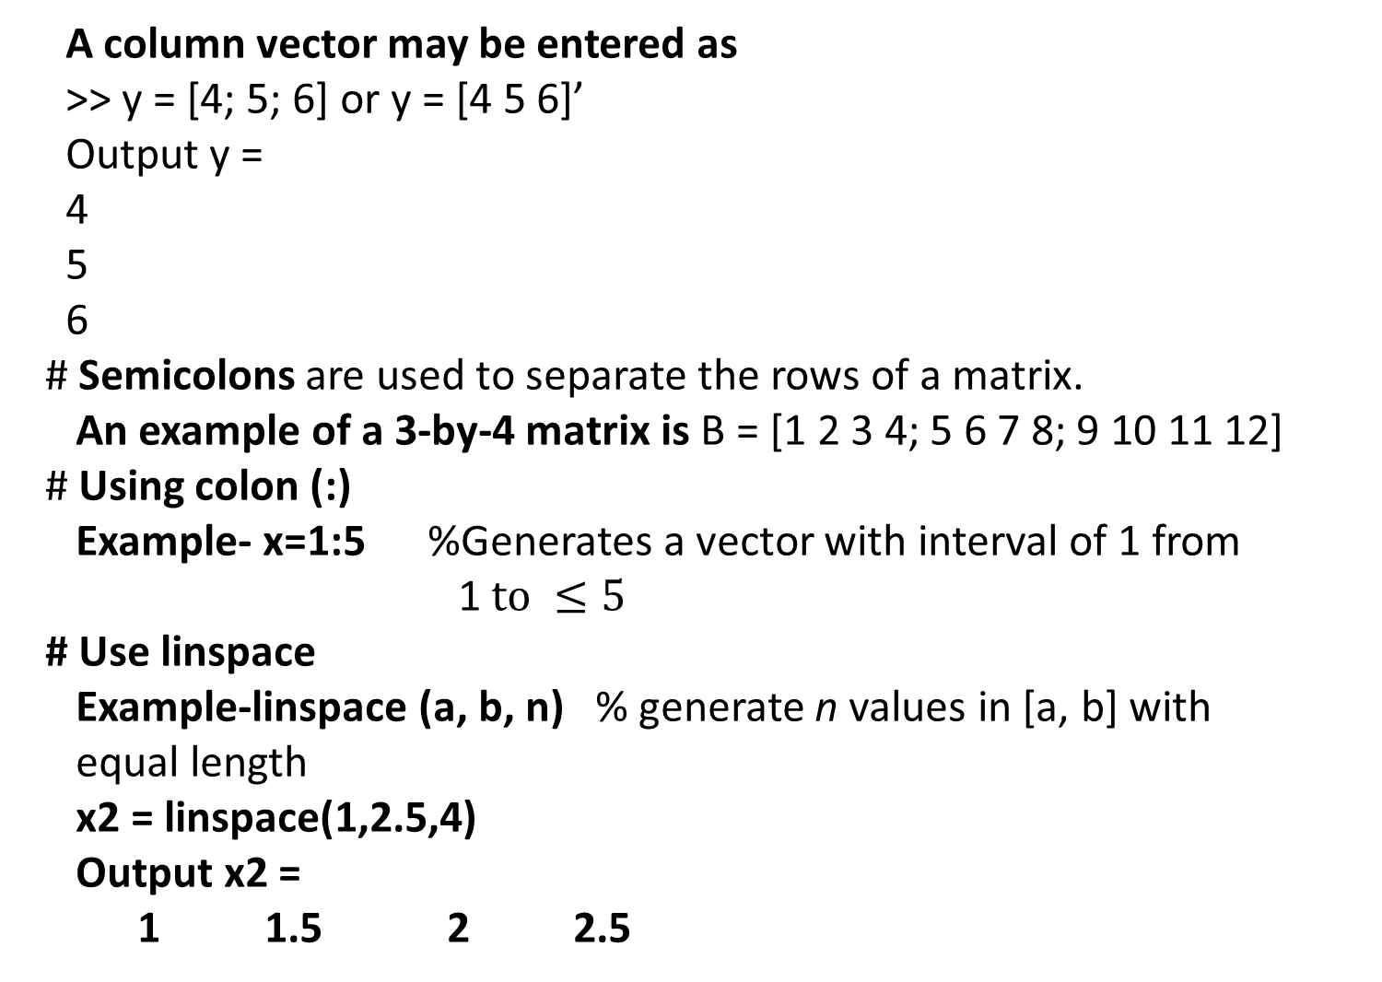
A column vector may be entered as
>> y = [4; 5; 6] or y = [4 5 6]’
Output y =
4
5
6
# Semicolons are used to separate the rows of a matrix.
An example of a 3-by-4 matrix is B = [1 2 3 4; 5 6 7 8; 9 10 11 12]
# Using colon (:)
Example- x=1:5 %Generates a vector with interval of 1 from
1$to ≤5$
# Use linspace
Example-linspace (a, b, n) % generate n values in [a, b] with
equal length
x2 = linspace(1,2.5,4)
Output x2 =
1 1.5 2 2.5

Slide 8
Controlling number of digits
The fixed-point numbers:
format short displays 5 digits
format long displays 16 digits
The floating-point representation:
format short e gives 5 digits plus the exponent
format long e gives 16 digits plus the exponent
The combined format (fixed point or floating depending on the magnitude of the number)
format short g
format long g

Slide 9
Printing command in MATLAB
By typing the name of a variable (displays the output indicating variable name).
Example- write the new script then save as “.m” file.
clear
>>A=[1, 2.25 4.56];
>> A
A =
1.0000 2.2500 4.5600
2. By using “disp” built in function. This displays output without variable name.
>>disp(A)
1.0000 2.2500 4.5600
3. By using “fprintf “ function
Syntax: fprintf(formatSpec, A₁, A₂, . . . , A₃)

Slide 10
Printing command in MATLAB
Example-
>>clear
>> x=0:0.5:2;
>> y=sin(x);
>>fprintf('%6s %12s\n','x','sin(x)');
x sin(x)
0.00 0.000000
0.50 0.479426
1.00 0.841471
1.50 0.997495
2.00 0.909297

Slide 11
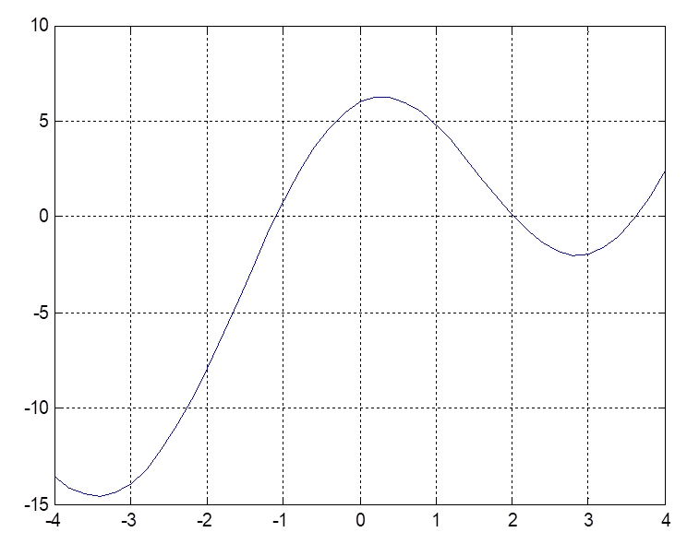
Plotting command in MATLAB
2-D Plot
plot(y) x = 1 : n (if not supplied)
plot(x,y) x, y are vectors
plot(x₁, y₁, . . .. , x_{n,}Y_{n})
title(‘plot title’) grid on grid off
xlabel(‘label for x-axis’) grid (toggles)
ylabel(‘label for y-axis’) hold on hold off
box on
Example #. Plot the function in [-4,4].
>> x= -4:0.2:4;
>> y=7*cos(x)+2*x-1;
>> plot(x,y);grid on

Slide 12
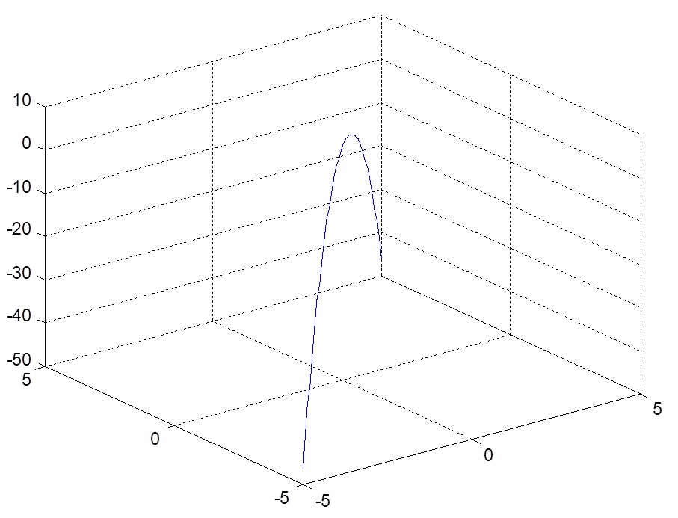
Plotting command in MATLAB
3-D Plot
plot3(x,y,z) % Command
Example #. Plot the function
>> x=linspace(-5,5,50);
>> y=x;
>> z=4-x.^2-y.^2;
>> plot3(x,y,z); grid on;
Construction of Functions in the Command Window
Example
>> f=inline('x^2+2*x*y')
f =
Inline function:
f(x,y) = x^2+2*x*y
>> v1=f(1, 2.2)
1. Inline function
f1 =jnline(expr)
f2=inline(expr, arg1, arg2,. . . )
Result
v1 =
5.4000

Slide 13
Construction of Functions in the Command Window
2. Function_handle (@) )
handle=@(arglist) anonymous_function
Example
>> ff=@(x,y) x.^2+x./y
ff =
@(x,y)x.^2+x./y
>> ff(1.1,2)
ans =
1.7600
3. Function using Symbols
>> syms x y
>> ff(x,y)=x.^2+x./y
ff(x, y) =
x^2 + x/y
To compute elementwise in array use
POWER with (.^) , DIVISION with (./) and PTRODUCT with (.*)
>> ff(1.2, 2) % returns result in fracttion
ans =
51/25
>> ffval=eval(ff(1.2,2)) % eval( ) is used to convert fraction
to decimal form
ffval =
2.04

Slide 14
m-Files
There are two types of programs (m-files) in MATLAB: Functions and Scripts.
User Defined Functions
To be created in function window.
To open: New → Function
To save: Save → enter file name and save
To run: Type function name in command window
To edit: Open → select the file from the list and edit. save again
function t=FF(a)
t=7*cos(a)+2*a-1;
end

Slide 15
m-Files
The function which is created as an m-file and saved as FF.m.
To use the above function type in command window.
>> t=FF(2)
t =
0.0870
Scripts
Scripts provide a set of MATLAB commands, comments, values, plotting commands, and so on.
A scripts that has been created and saved is executed by typing the file name at the MATLAB prompt in the command window or using save and run from the Debug menu.
To open: New → Script
To save: Save → enter file name and save
To run: Type script name in command window
To edit: Open → select the file from the list and edit. Save again

Slide 16
Scripts
% Script TestProgm
%Values of f(x) for different values of x
x= x0;
disp('n xn f(xn)')
for i=1:nmax
fx=f(x);
n=i-1;
disp([n,x,fx])
x=x+h;
end
Save the script as TestProg.m
To execute the script from Command Window, type following commands:
>> clear
>> x0=1;
>> h=0.5;
>> f=inline('7.*cos(x)+2.*x-1')
f =
Inline function:
f(x) = 7*cos(x)+2*x-1
>> nmax=5
nmax =
5
>> TestProg % Type the Script name
Output
n xn f(xn)
0 1.0000 4.7821
1.0000 1.5000 2.4952
2.0000 2.0000 0.0870
3.0000 2.5000 -1.6080
4.0000 3.0000 -1.9299

Slide 17
Programming in MATLAB
Normally in a programming language, it is necessary to specify type of variable used in the program (integer, real, complex, and so on). MATLAB treats all variables as matrices (whatever dimension is needed) and perform the necessary calculations.
To repeat similar calculations several times for and while loops are used. Syntax are
For Loops
for i = 1 : k
commands . . .
end
While Loops
while statement == true
commands . . .
end
Example #: Write MATLAB codes for calculating n! using for loop.
>> clear
>> n=input('please input number = ');
fact=1;
i=1;
for i=1:n
fact=fact*i;
i=i+1;
end
disp(fact)
Outcome:
please input number = 5
120

Slide 18
Conditional execution can be indicated by if statement.
if expression
commands . . .
end
If there are more alternatives, the form is
if expression1
commands . . .
elseif expression2
commands . . .
elseif …
. . .
end
Break and Error
The break command causes MATLAB to jump outside the loop in which it occurs.
The error command abort function execution , displays a character string in the command Window, and returns control to the keyboard.
Computer Algebra System (CAS) with MATLAB
MATLAB contributes to solve in numerous common mathematical areas such as calculus, linear algebra, algebraic equations differential equations and so on. MATLAB also provides symbolic calculations and manipulations symbolic mathematical expression. For this purpose we need to define the symbols and it can be done by using the MatLab default command ‘syms ’.

Slide 19
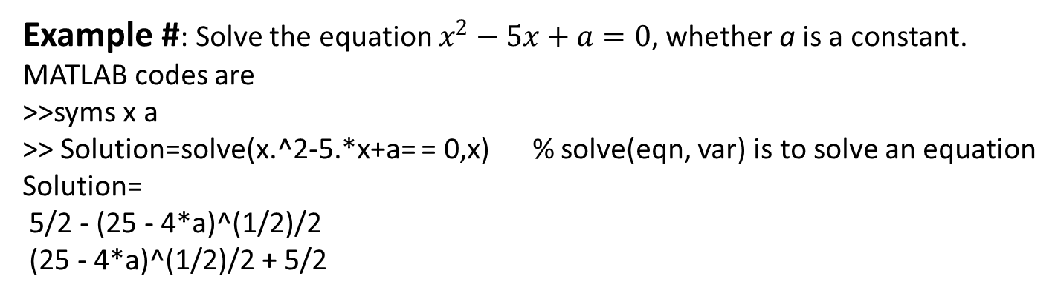
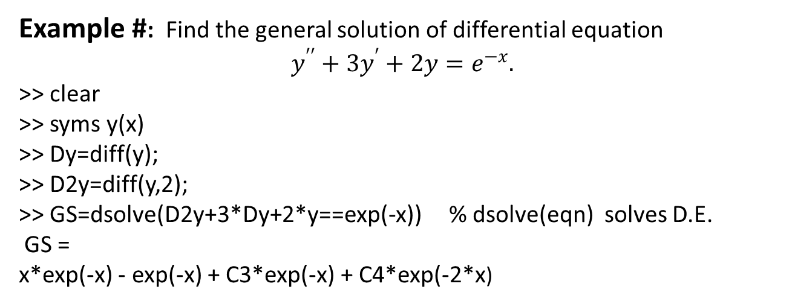
Solve problems using Basic commands and Syntax
Example #: Solve the equation $x^{2}−5x+a=0$, whether a is a constant.
MATLAB codes are
>>syms x a
>> Solution=solve(x.^2-5.*x+a= = 0,x) % solve(eqn, var) is to solve an equation
Solution=
5/2 - (25 - 4*a)^(1/2)/2
(25 - 4*a)^(1/2)/2 + 5/2
Example #: Find the general solution of differential equation
$$y^{′′}+3y^{′}+2y=e^{−x}.$$
>> clear
>> syms y(x)
>> Dy=diff(y);
>> D2y=diff(y,2);
>> GS=dsolve(D2y+3*Dy+2*y==exp(-x)) % dsolve(eqn) solves D.E.
GS =
x*exp(-x) - exp(-x) + C3*exp(-x) + C4*exp(-2*x)

Slide 20
Representation of Numbers in MATLAB
Decimal places (d.p.):
The number of digits counted after the decimal marker.
Significant figures (s.f.):
All digits including zero are counted from the first non-zero digit.
Rounding:
The last retained digit is corrected up if the succeeding digit is greater than or equal to 5, otherwise chopped off.
Error Measurement
Numerical calculations can be in error due to the use of approximate values in the calculation. The following definitions are used in measuring the errors.
Absolute error =⏐True value − Approximate value⏐
Relative error=
Percentage of error = Relative error × 100 %

Slide 21
Note that in absence of true value an approximate relative error,
can be estimated by using the relation
Rounding Error
If 2.326 is a number rounded to 3 d.p., the true value α is
Thus the maximum absolute error is
If a number is rounded to n decimal places, the maximum absolute error is

Slide 22
Consider two numbers 235.3 and 0.003267 which are rounded to 4 s.f.. The errors can be estimated as follows
For 235.3, the relative error is
For 0.003267. the relative error is
In general, if a number is rounded to n significant figures the maximum relative error is
The table below shows various errors corresponding to the given true and approximate values.

Slide 23
Solve problems using Basic commands and Syntax
Example #:
The solution of the quadratic equation
is
Write a MATLAB script to solve the quadratic equation with variable coefficients which gives variable significant digits.
Solution:
% Script QuadEq for solution
clear all
disp('Solution of Quadratic Equation')
% Equation : ax^2+bx+c=0
% Roots: x1= -b+sqrt(b^2-4ac)/(2a)
% x2= -b-sqrt(b^2-4ac)/(2a)
abc=input('Supply a,b,c as [a,b,c]=');
a=abc(1); b=abc(2); c=abc(3);
x1=(-b+sqrt(b^2-4*a*c))/(2*a);
x2=(-b-sqrt(b^2-4*a*c))/(2*a);
Roots=[x1,x2]
disp('Roots to n significant digits')
n=input('Value of n = ');
Roots_n=vpa([x1; x2],n)

Slide 24

Outcomes
Numerically solve problems by using different mathematical methods, built in function in MATLAB
Visualization problems by data analysis
Save time for solve problems
Try to do yourself
Exercise 1:
Write script and solve the following equation then correct it to ten significant figures.
Exercise 2:
Find the general solution of the following ordinary differential equation (ODE)
$$y^{′′}−2y^{′}+10y=5x−e^{3x}$$

Slide 25
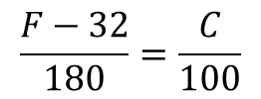
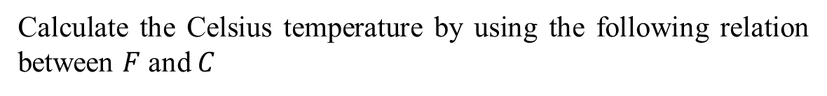
Exercise 3:
Calculate the Celsius temperature by using the following relation between $F$ and $C$
$$\frac{F−32}{180}=\frac{C}{100}$$
where the range of Fahrenheit temperatures from 10 to 200 with interval 5.
Then print these values with the proper headings by using the “fprintf” command in MATLAB.
References
Text Book:
Applied Numerical Methods with MATLAB for Engineers and Scientists- S.C. Chapra, 4th Edition, 2017, McGraw Hill-Europe.
Reference Book:
Numerical Methods in Engineering with MATLAB – Jaan Kiusalaas, 4th Edition, 2018, CAMBRIDGE UNIVERSITY PRESS, UK.
Applied Numerical Methods With Matlab for Engineers and Scientists ( Steven C.Chapra).

